Slide 1
Image compression with Haar wavelets Group 1
Name | Roll Number
Dev Jani | AU1940045
Yashvi Navadia | AU1940123
Vishwa Raval | AU1940131
Darsh Patel | AU1940150

Slide 2
Introduction
Project Definition: - The project aims to address the problem of a low complex 2D Image Compression using the Haar Wavelets as the basis functions. - Also, to calculate the quality of compressed images using Peak Signal to Noise Ratio (PSNR) factor [1].
About wavelets:
Wavelets layer the data in level-wise details and obtain a mathematical method for encoding numerical data.
The layering can simplify approximations at intermediate stages, leading to less space for data storage. - The Haar Wavelet
Link between Linear Algebra and wavelets
Software used: MATLAB
Need of Image compression: To conserve more transfer energy and save storage of data, and overcome the problem of costly network traffic due to large size of original data files. The compression type could be lossy or lossless.

Slide 3
Linear Algebra Concepts Used
List of basic LA concepts used:
Basis of a vector space (Standard basis, Orthogonal basis)
Vector subspace
Change of basis
Orthogonal complements
Orthogonal projection
Orthogonalization of a set of vectors in the basis
Orthonormal basis
Inner Product Space
An overview of Mathematical Process of compression through Haar Wavelets:
INPUT: A vector space V_{n}
Represented by
“box basis”
Change of basis
OUTPUT: A new basis known as
“The Haar Basis”

Slide 4
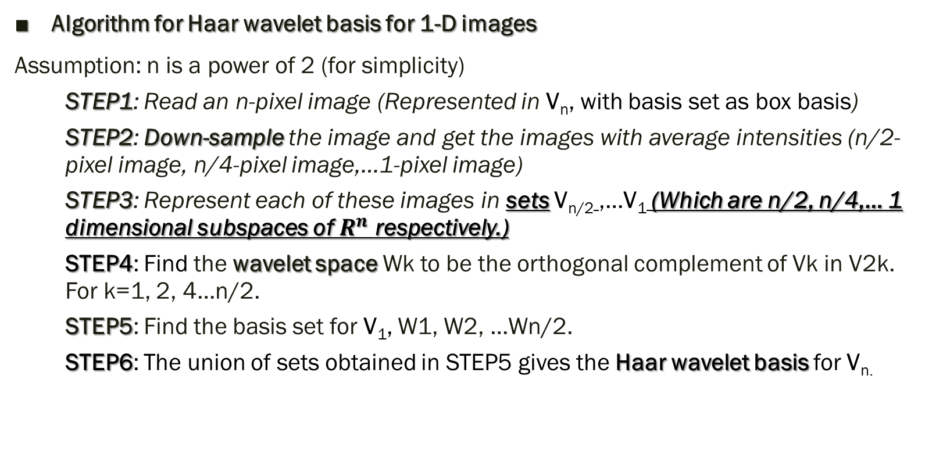
Mathematical Process for change of basis
Algorithm for Haar wavelet basis for 1-D images
Assumption: n is a power of 2 (for simplicity)
STEP1: Read an n-pixel image (Represented in V_{n}, with basis set as box basis)
STEP2: Down-sample the image and get the images with average intensities (n/2-pixel image, n/4-pixel image,…1-pixel image)
STEP3: Represent each of these images in sets V_{n/2} ,…V₁ (Which are n/2, n/4,… 1 dimensional subspaces of $R^{n}$ respectively.)
STEP4: Find the wavelet space Wk to be the orthogonal complement of Vk in V2k. For k=1, 2, 4…n/2.
STEP5: Find the basis set for V₁, W1, W2, …Wn/2.
STEP6: The union of sets obtained in STEP5 gives the Haar wavelet basis for V_{n.}

Slide 5
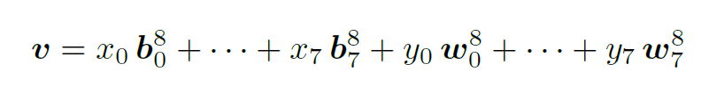
Mathematical Process for finding wavelet coefficients
Process: Finding the coordinate vector of the image vector, with respect to the Haar wavelet basis, given the “Box basis”
STEP1 of wavelet transformation: representing the image vector as a linear combination of vectors in the basis of Vk and that in Wk.
Example for n=16 case:
x_{i}’s can be obtained by averaging and y_{i}’s can be obtained by differencing.
INPUT: List of intensities of original n-pixel image. i.e. a vector in V_{n}
OUTPUT: (n-1) wavelet coefficients (using differencing), plus one overall average intensity.

Slide 6

Subsequent steps of wavelet decomposition:
Down-sampling/ Decimation:
A two-dimensional image with higher resolution can be divided into little (2 × 2) blocks of pixels, and each block is replaced by a pixel with intensity equal to the average of the intensities of the pixels it replaced. This process is known as Down-sampling or Decimation
Image from “Coding the Marix” –
A simple example of down-sampling of 16-pixel 1-D image to 1-pixel 1-D image through averaging

Slide 7
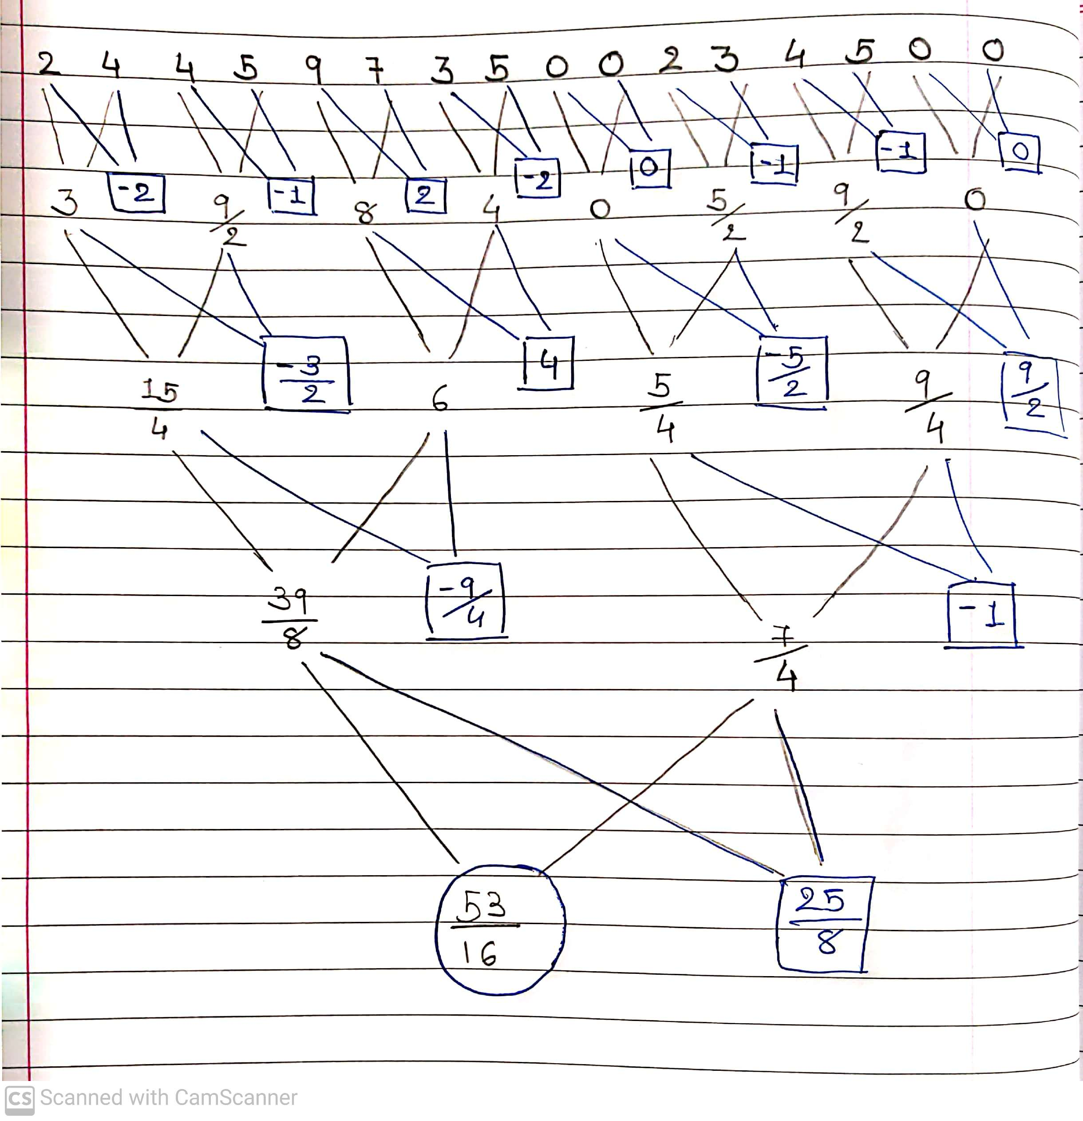
Down-sampling using averaging at the end yields overall average intensity. Which will be the coefficient of V₁, while representing the image vector as LC of the Haar basis.
Differencing in each down sampled image yields n/2 + n/4 + n/8 + · · · + 2+1 = n − 1 terms, the will be wavelet coefficients.
A simple example:

Slide 8
From orthogonal to orthonormal
The Haar Wavelet basis obtained from this method would be an Orthogonal Basis.
Multiplying and dividing each term in the linear combination representation by the norm of corresponding vector yield orthonormal basis.
So, the coordinate vector changes accordingly,

Slide 9
Approach (Functionalities and Errors)
Functionalities:
The 2-Dimensional image compression which we implemented involves considering the input image as a 2-Dimensional array or matrix (orthogonal set of vectors in 2-D vector space), which is down-sampled to a matrix which consists of averages and differences of the values from original matrix. Filtering out the matrix which holds the averages (half the size of original matrix) gives the compressed image.
Even though it is lossless approach but lossy transformation takes place as the difference values are either discarded or changed and hence the original matrix (image) cannot be obtained by applying image transformation.
Errors:
We will be using only Grayscale images as input in Haar wavelet Transform due to the reason that the colour gray colour has one , whereas the RGB has 3 componants. Dealing with one intensity is prefered over 3 intensities simultaneously for computational advantages like less time consuming and better implementation.

Slide 10
Coding and Simulation
Part 1: MATLAB Library functions that are used in code
“Imread” reads grayscale image as data from the file and returns 2-Dimensional array as image data.
“Imshow” plots image after taking image data as input.
“Filename.bytes” returns the size of specified file in bytes.
“Imwrite” writes a file with ‘.jpg’ format after taking specified image data as input.

Slide 11


Part 2: User Defined Functions and their contribution in performing 2-D Haar Wavelet Transform.
”quality_measure.m” - takes original and compressed image data as input and returns the corresponding PSNR value.
“haar_DWT(a)”
Takes ‘a’ as in input image data in form of Matrix (2-D vector space consisting of Orthogonal set of vectors).
‘a’ goes through iterative loops which deals with row-wise and column-wise transformations which gives a new matrix ‘z’ consisting of averages and differences values of elements from ‘a’ as shown in figure.
>>

Slide 12

>>
From ‘z’, a new matrix half the size of ‘a’ is filtered out (using the conditional assignment statement), a new matrix consisting of the average values which represents the compressed image (matrix) as shown in figure above.
The concept that enables such compression is that the compressed or down-sampled two-dimensional which will be a ‘set’ of the original 2-D arrays assumed and proved in One-Dimensional Array Transform.
Another interesting concept is followed here, any basis in this two-dimensional (original) vector space can be obtained from any basis from each of its further compressed two-dimensional vector space (compressed matrix) that was something that we proved for One-Dimensional Array.
Hence our assumptions are true and LL can represent the compressed image.

Slide 13
Conclusion
Haar wavelet based image compression is computationally efficient and effective to compress a grayscale image.
It shows high compressibility factor and follows a lossy compression with maintained quality standards (Above 15 dB PSNR values)
Using concepts like 1-D and 2-D transformation of Haar basis, Vector spaces, orthogonal set vectors,etc with count-controlled execution gives us a time efficient algorithm which is best suited for GrayScale images, and not for colour images (RGB) as components gets scattered which means more time implementing it and less efficient.

Slide 14
THANK YOU

